Slide 2
Addressing climate change with help of Machine learning Emerald 09:00 - 09:45
Tomaž Kaštrun, Data Platform MVP
29.09.2021

Slide 3

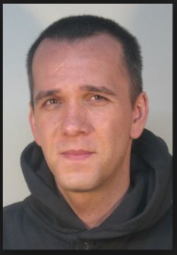


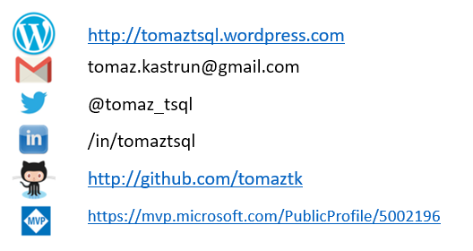
About
BI Developer | data analyst | data scientist
SQL Server, SAS, R, Python, C#, SAP, SPSS
20years experience MSSQL, DEV, BI, DM
Frequent community speaker
Avid coffee drinker & bicycle junkie

Slide 4
Abstract
Climate change is a fact, it is happening, and we need not only actively participate in tackling it, but also we need to raise awareness. One area that can be identified is the area of using and implementing machine learning algorithms and techniques to tackle climate change. Addressing this issue can be done using machine learning and different approaches to tackling it, from mitigating or reducing and stopping CO2 emissions or adapting to the changes that climate change will bring. With the help of Microsoft Azure services, we will go through some of the machine learning concepts and how Azure can help us address, reduce, adapt to these issues or which tools can be found in Azure to help take actions and address policies. The session will look into climate change modeling, efficient sensing, biodiversity, solar geo-modeling, transportation, and electricity with the help of Machine Learning and Microsoft Azure.

Slide 5
The heat is on!
7.500 major disaster events were recorded in past 20 years
Claiming 1.2 milion lives, BUT affecting 4.2 billion people
Result is approx. 3 trillion USD losses in global economic
In 2019 alone we recorder aw the highest CO₂ emissions in human history.
How can AI help?

Slide 6
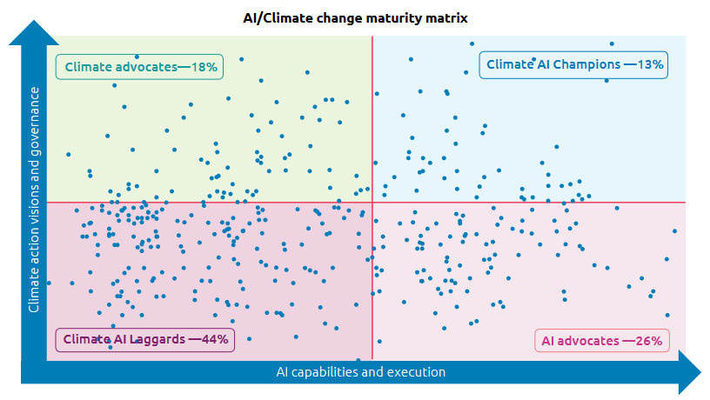
Organizations are struggling
Climate action should be top priority for organizations
Aligning organization vision with climate vision and strategy
Lack of investements and knowledge
Capgemini
N=400
Jun-Aug 2020
Source: https://www.capgemini.com/wp-content/uploads/2020/12/Report-Climate-AI.pdf

Slide 7
Actionable plan?
Mitigation
Electricity systems
Transportation
Builidings and cities
Industry
Farms and forests
Carbon dioxide removal
Adaptation
Climate prediction
Societal impact
Solar geoengineering
Actions and tools
Individual actions
Collective decisions
Finance
Education
Plan and vision

Slide 8
Agenda
Approaches for tackling climate change
Mitigating and reducing the CO2 emission
Adapting to changes
Each segment will have a proposed Microsoft Azure architecture

Slide 9
1
Approaches for tackling climate change

Slide 10
Tackling issues
Predicting rare events
Scheduling the renewables
Accelerating forestation
Image analysis and neural networks

Slide 11
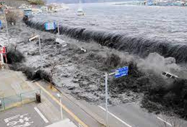
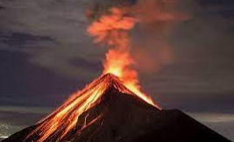
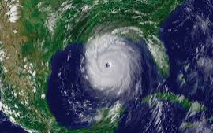
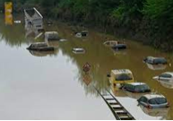
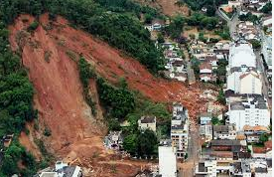
1.1 Predicting rare events
Decision forests
Numerical simulations
GBM
Boosting algorithms for better recall-precision balance (AdaCost, PNRule)
Corresponding short-term predictions for chaotic systems
Multifidelity stohastic computational models (HiFi Monte Carlo + LoFi Markov chain)

Slide 12
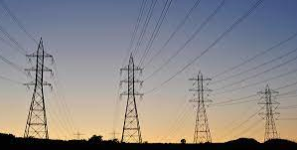
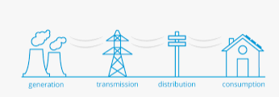
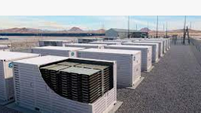

1.2 Scheduling and planning the renewables
Short- and medium-term forecasting of consumption (historical data, physical and image data)
Decision-focused forecasting
Reinforcement learning to accomodate system balancing
Enabling decentralized optimization for solar and wind production using control theory with enforced deep learning
Wind turbines optimization, Peak-shaving

Slide 13
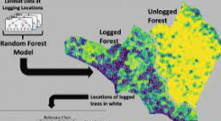
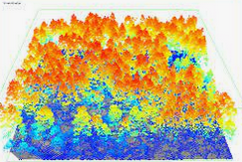
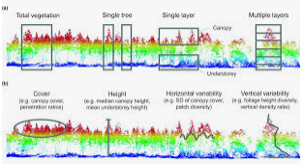
1.3 Accelerating forestation
Land abandoment detection (CNN on Landsat or Sentinel)
Remote sensing for deforestation (Open forrest project)
Illegal and optimal selective logging
Mapping plantations and succesional forests (Random Forest, SVM, ANN)
Remote sensing datasets (Landsat optical data, ALOS/PALSAR L-band, Lidar)
Canopy height model (CHM)
Categorization of light detection and ranging vegetation
Numeric hydroclimate models with Physics-informed cGANs

Slide 14
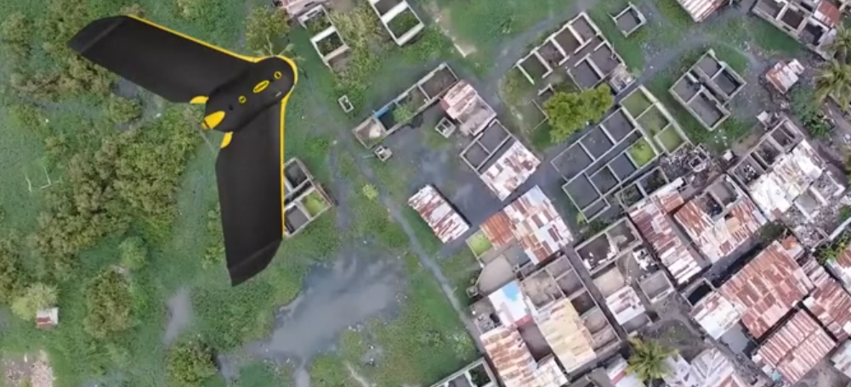


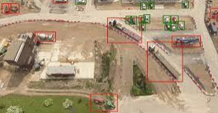
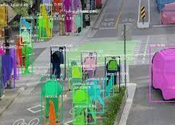
1.4 Image Analysis
Understanding land and land use attributes
Machine Learning for Remote sensing
Satellite images
Aerial or drone imagery (LiDAR, color images, etc)
Object detections
Semantic segmentation
Spatio-temporal forecasting
Super-resolutioning or image pixelization

Slide 15
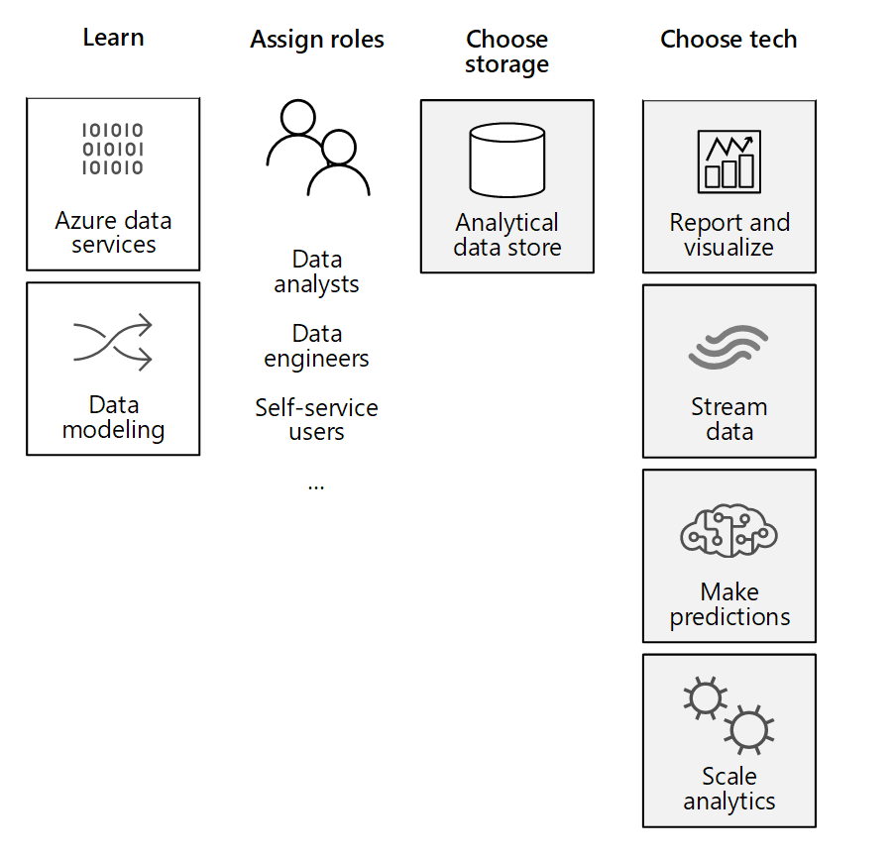
Personas and technology

Slide 16
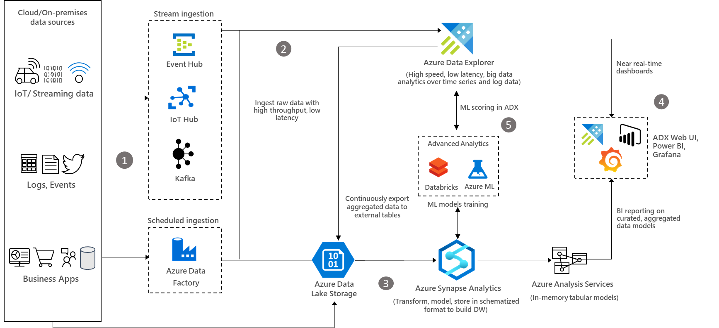
Architecture - Big Data Anaytics with Azure Explorer
Notes:
Data flow
Raw structured, semi-structured, and unstructured (free text) data such as any type of logs, business events, and user activities can be ingested into Azure Data Explorer from various sources.
Ingest data into Azure Data Explorer with low-latency and high throughput using its connectors for Azure Data Factory, Azure Event Hub, Azure IoT Hub, Kafka, and so on. Alternatively, ingest data through Azure Storage (Blob or ADLS Gen2), which uses Azure Event Grid and triggers the ingestion pipeline to Azure Data Explorer. You can also continuously export data to Azure Storage in compressed, partitioned parquet format and seamlessly query that data as detailed in the Continuous data export overview.
Export pre-aggregated data from Azure Data Explorer to Azure Storage, and then ingest the data into Synapse Analytics to build data models and reports.
Use Azure Data Explorer’s native capabilities to process, aggregate, and analyze data. To get insights at a lightning speed, build near real-time analytics dashboards using Azure Data Explorer dashboards, Power BI, Grafana, or other tools. Use Azure Synapse Analytics to build a modern data warehouse and combine it with the Azure Data Explorer data to generate BI reports on curated and aggregated data models.
Azure Data Explorer provides native advanced analytics capabilities for time series analysis, pattern recognition, anomaly detection and forecasting, and machine learning. Azure Data Explorer is also well integrated with ML services such as Databricks and Azure Machine Learning. This integration allows you to build models using other tools and services and export ML models to Azure Data Explorer for scoring data.

Slide 17
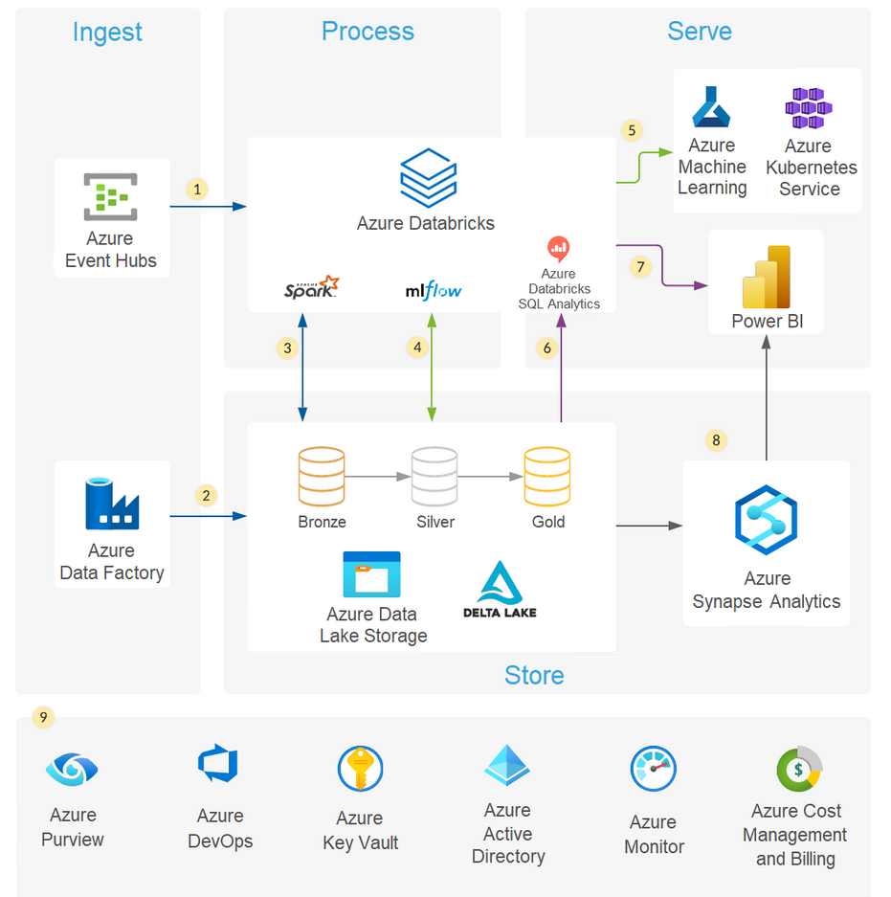
Architecture – modern analytics with Databricks
Notes:
Azure Databricks ingests raw streaming data from Azure Event Hubs.
Data Factory loads raw batch data into Data Lake Storage.
For data storage:
Data Lake Storage houses data of all types, such as structured, unstructured, and semi-structured. It also stores batch and streaming data.
Delta Lake forms the curated layer of the data lake. It stores the refined data in an open-source format.
Azure Databricks works well with a medallion architecture that organizes data into layers:
Bronze: Holds raw data.
Silver: Contains cleaned, filtered data.
Gold: Stores aggregated data that's useful for business analytics.
The analytical platform ingests data from the disparate batch and streaming sources. Data scientists use this data for these tasks:
Data preparation
Data exploration
Model preparation
Model training
MLflow manages parameter, metric, and model tracking in data science code runs. The coding possibilities are flexible:
Code can be in SQL, Python, R, and Scala.
Code can use popular open-source libraries and frameworks such as Koalas, Pandas, and scikit-learn, which are pre-installed and optimized.
Practitioners can optimize for performance and cost with single-node and multi-node compute options.
Machine learning models are available in several formats:
Azure Databricks stores information about models in the MLflow Model Registry. The registry makes models available through batch, streaming, and REST APIs.
The solution can also deploy models to Azure Machine Learning web services or Azure Kubernetes Service (AKS).
Services that work with the data connect to a single underlying data source to ensure consistency. For instance, users can run SQL queries on the data lake with Azure Databricks SQL Analytics. This service:
Provides a query editor and catalog, the query history, basic dashboarding, and alerting.
Uses integrated security that includes row-level and column-level permissions.
Uses a Photon-powered Delta Engine to accelerate performance.
Power BI generates analytical and historical reports and dashboards from the unified data platform. When working with Azure Databricks, this service uses these features:
A built-in Azure Databricks connector for visualizing the underlying data.
Optimized Java Database Connectivity (JDBC) and Open Database Connectivity (ODBC) drivers.
Users can export gold data sets out of the data lake into Azure Synapse via the optimized Synapse connector. SQL pools in Azure Synapse provide a data warehousing and compute environment.
The solution uses Azure services for collaboration, performance, reliability, governance, and security:
Azure Purview provides data discovery services, sensitive data classification, and governance insights across the data estate.
Azure DevOps offers continuous integration and continuous deployment (CI/CD) and other integrated version control features.
Azure Key Vault securely manages secrets, keys, and certificates.
Azure Active Directory (Azure AD) provides single sign-on (SSO) for Azure Databricks users. Azure Databricks supports automated user provisioning with Azure AD for these tasks:
Creating new users.
Assigning each user an access level.
Removing users and denying them access.
Azure Monitor collects and analyzes Azure resource telemetry. By proactively identifying problems, this service maximizes performance and reliability.
Azure Cost Management and Billing provides financial governance services for Azure workloads.

Slide 18
2
Mitigating and reducing
CO2 emissions

Slide 19
Mitigations and lowering CO2
Farms and agriculture
Transport
Buildings and cities

Slide 20
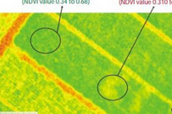
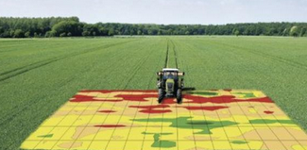
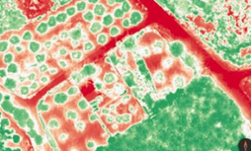
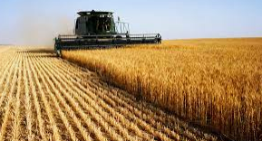
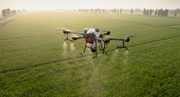
2.1 Farms and agriculture
Optimization algorithms for precision agriculture
LiDar and remote sensoring for (over) heating and soil structure and management
Agricultural desease detection and invaluable crop detection
Neural Networks for water and crop management using IoT
Crop yield predictions using aerial data to improve moisture, fertilization and natural nutrient level

Slide 21
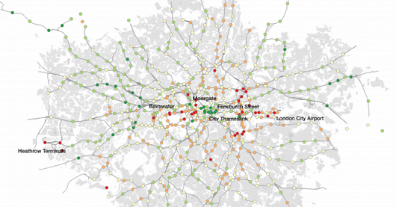
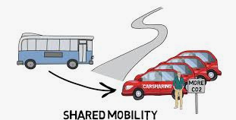


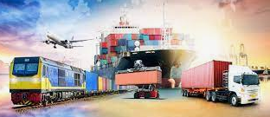
2.2 Transport
Polycentric urban forms and use of graph theory
Theory based residual neural network (ResNet)
Spatiotemporal topic model
Discovering latent activity patterns on spatiotemporal data
Modelling transport demands and calculating impact on shared mobility concepts
Optimizing freight routing and bundling
Improving EV and low-carbon transportation

Slide 22
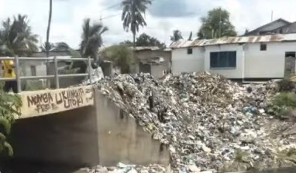
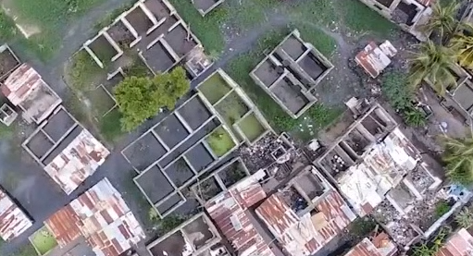
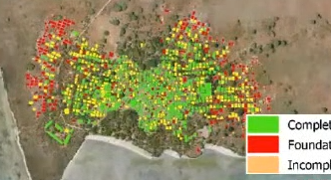
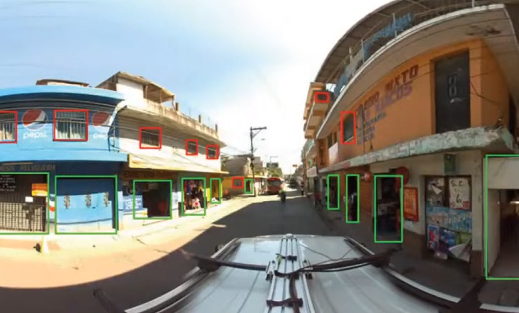
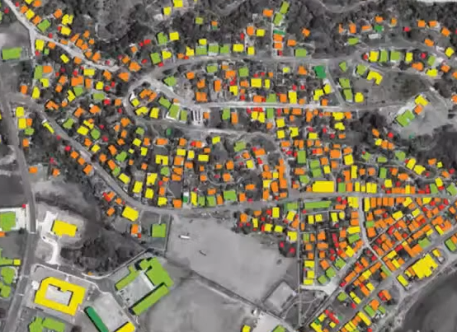
2.3 Buildings and cities
Shock responsive dwellings and cities for drought with remote sensing and local administrative data
Flood cities remote sensing using drone technology
Identification of foundation | construction | complete buildings
Resilient housing for retrofit possibilities for landslides or hurricanes
Urban tree canopy for better greenery, temperature and lifestyle

Slide 23
Personas and technology

Slide 24
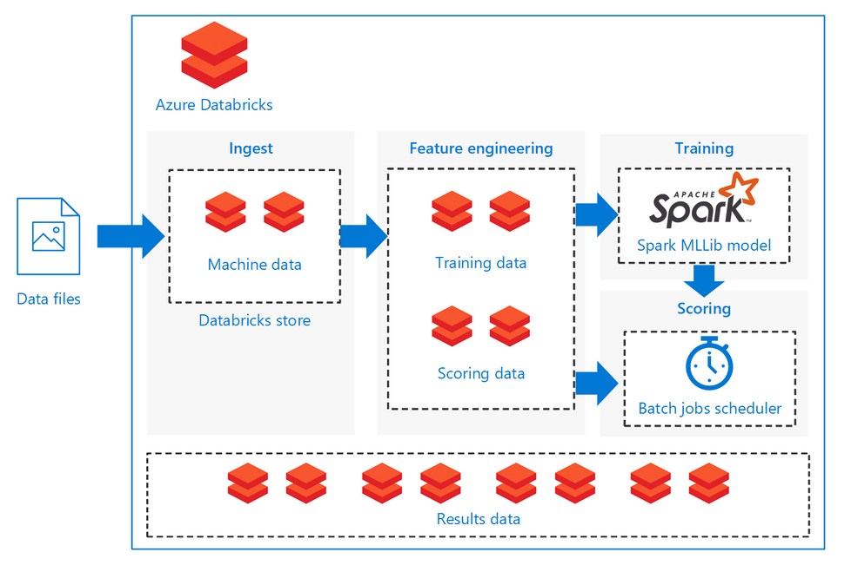
Architecture – Batch scoring of Spark models with Databrics

Slide 25
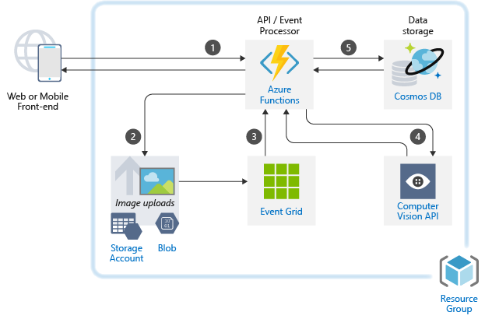
Architecture – Image classification

Slide 26
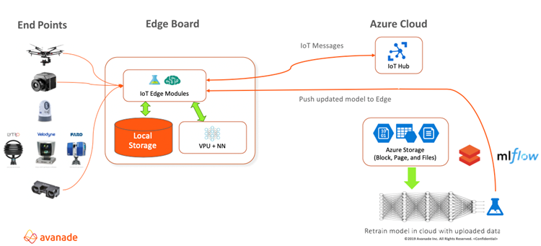
Architecture – contactless IoT interfaces with Azure intelligent edge

Slide 27
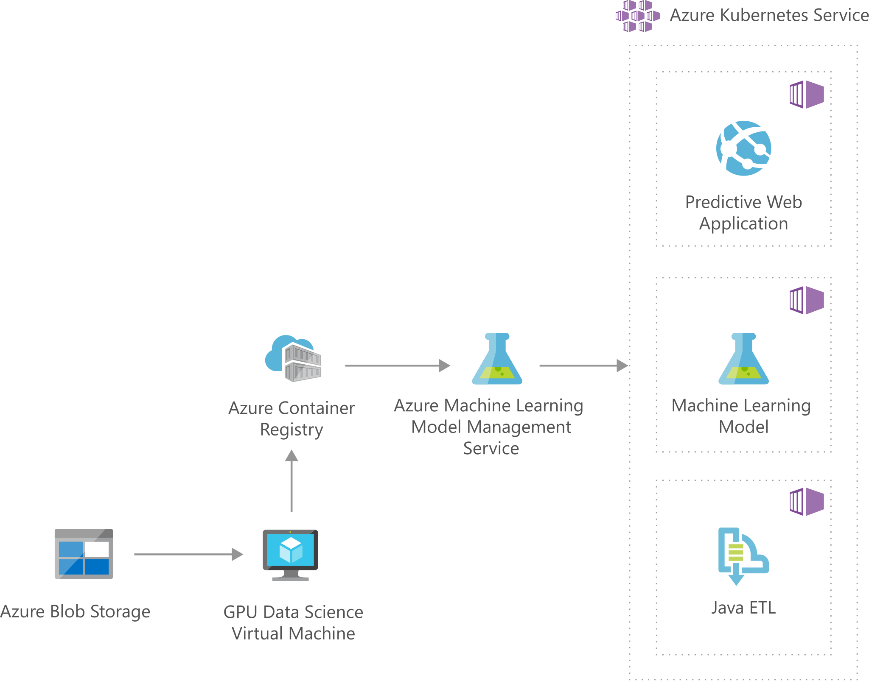
Architecture – Image classification with CNN

Slide 28
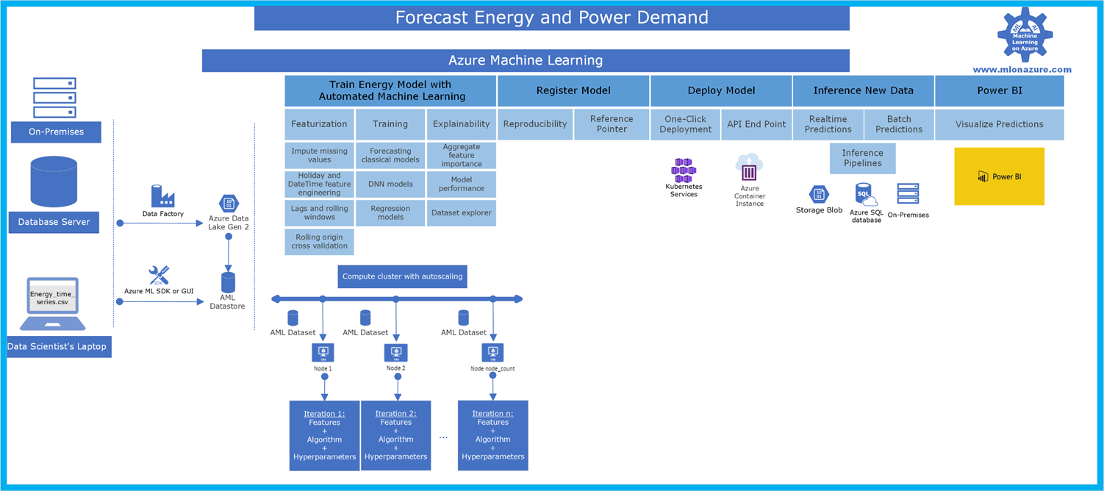
Architecture – Forecasting energy and power Demand

Slide 29
3
Adapting to changes

Slide 30
What can we do today?
The green plan for EU 2050
- Combat the negative impact of AI on the climate
- Educate their employees on the criticality of climate change and explain how AI can make a real difference
- Establish technological foundations for AI-powered climate change action
- Scale specific use cases
- Collaborate with the climate change ecosystem

Slide 31
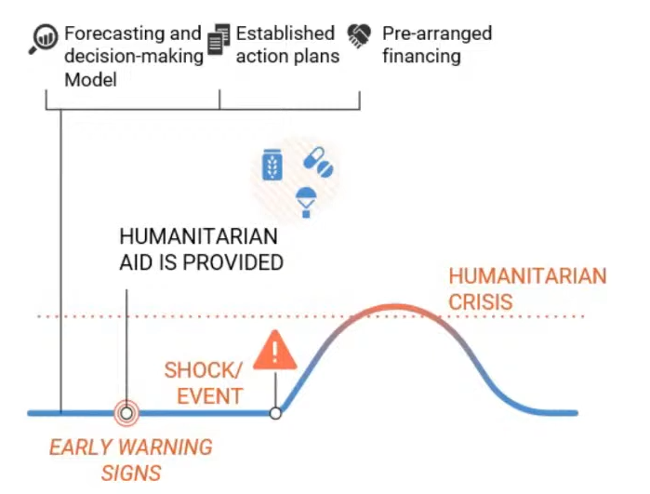
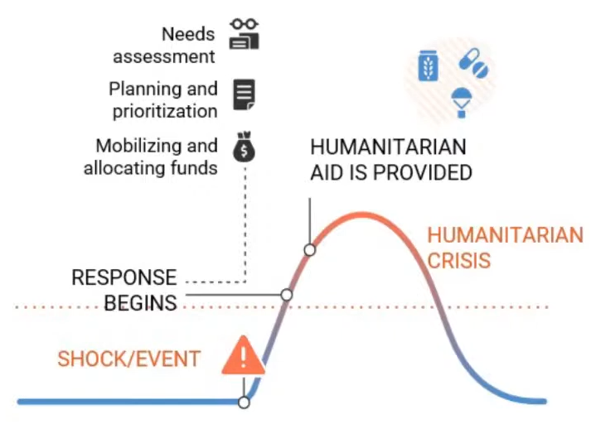
Humanitarian response
Probability models for predicting crisis (drought, flood, fire, avalanches)
Source: https://www.capgemini.com/wp-content/uploads/2020/12/Report-Climate-AI.pdf

Slide 32
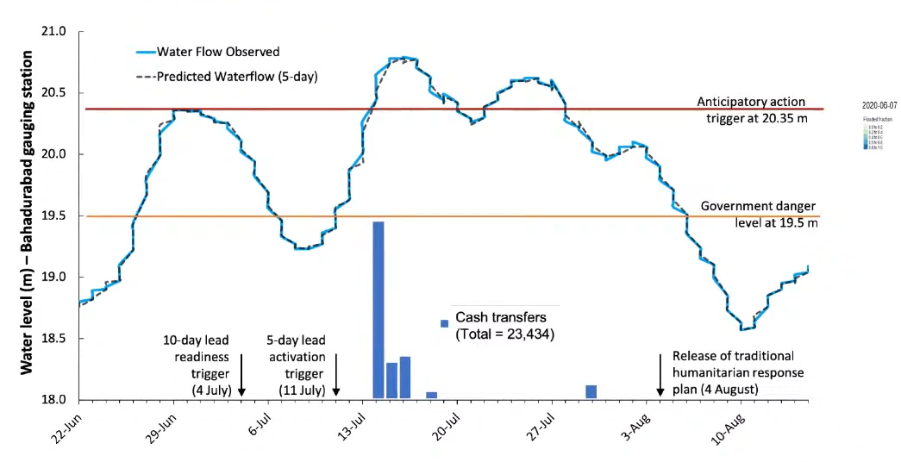
Crisis are decentralized; help usually is not
Before hand humanitarian response plan
Triggered release of cash (case of Bangladesh flooding in 2020)

Slide 33
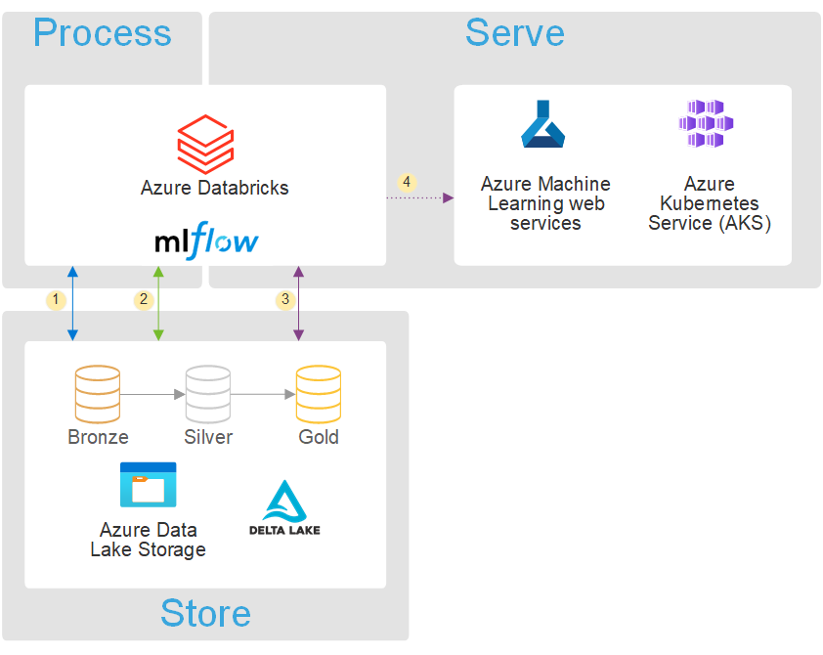
Architecture – Data science and analytics with Databricks

Slide 34
Impact on society and humans
Drought impacts the agriculture
Sea level impacts and threatens coastal cities
Local crisis have global impacts and global crisis have local impacts
Lowering GHG and GHG emissions will have contra-effect
Abandon the usage of fossil fuels will have impact on other natural resources (less fossil, more wind and solar)

Slide 35
Key take-aways
AI and ML will have gain more importance over time
Many different industries and fields can use the power of AI/ML
Architecture, computers and scalable services are powerfull than ever
Many events, tasks, daily operations can be data-driven, automated and superseeded by an ML algorithm
Every human being can make a change. On a daily basis.
If you don‘t know, ask!

Slide 36
Stay aware!

